Slide 1
The Client Server Model & HTTP
Web Programming

Slide 2
Overview
DNS – Quick explanation
Client Server Model
What are protocols?
The Hypertext Transfer Protocol (HTTP)
Practical example
Step by step through the request pipeline
Other protocols
Browsers
Website Caching
Notes:
https://www.youtube.com/watch?v=8KuO4r5CHjM - CS75 (Summer 2012) Lecture 0 HTTP Harvard Web Development David Malan

Slide 3
DNS?
Domain Name System
Translates from domain to IP address
www.ucn.dk → 81.27.214.15
YouTube video: DNS Explained
Notes:
Also a protocol

Slide 4


Client Server Model
Request for web page
Request for web page
Network / Internet
Web page HTML file
Web page HTML file
Client
Server

Slide 5
Client Server Model
The browser is the client, WWW (or web) server is the server.
Browser:
The browser makes TCP connection to the web server.
The browser sends request for the particular web page that it wishes to display.
The browser reads the contents of the web page from the TCP connection and displays it in the browsers window.
The browser closes the TCP connection used to transfer the web page.
Each separate item in a web page (e.g., pictures, audio) require a separate TCP connection.
HyperText Transport Protocol (HTTP) specifies commands that the client (browser) issues to the server (web server) and the responses that the server sends back to the client.

Slide 6
Web Server Basics
Duties
Listen to a port
When a client is connected, read the HTTP request
Perform some lookup function
Send HTTP response and the requested data

Slide 7
Serving a Page
User of client machine types in a URL
Client (Chrome / Firefox / Safari / IE)
Server (Apache / IIS)
http://www.thelittleco.com/index.html

Slide 8
Serving a Page
Server name is translated to an IP address via DNS
Client (Chrome / Firefox / Safari / IE)
Server (Apache / IIS)
http://www.thelittleco.com/index.html
192.22.107.5

Slide 9
Serving a Page
Client connects to server using IP address and port number
Client (Chrome / Firefox / Safari / IE)
Server (Apache / IIS)
192.22.107.5 port 80
http://www.thelittleco.com/index.html
192.22.107.5

Slide 10
Serving a Page
Client determines path and file to request
Client (Chrome / Firefox / Safari / IE)
Server (Apache / IIS)
http://www.thelittleco.com/index.html

Slide 11
Serving a Page
Client sends HTTP request to server
Client (Chrome / Firefox / Safari / IE)
Server (Apache / IIS)
GET index.html HTTP/ 1.1
http://www.thelittleco.com/index.html

Slide 12
Serving a Page
Server determines which file to send
Client (Chrome / Firefox / Safari / IE)
Server (Apache / IIS)
http://www.thelittleco.com/index.html
”index.html” is really /etc/httpd/htdocs/index.html
Notes:
Instead of serving a static HTML file, the Server can execute programs that generate the HTML to send to the Client

Slide 13
Serving a Page
Server sends response code and the document
HTTP/1.1 200 OK content-type: text/html
[contents of index.html]
Client (Chrome / Firefox / Safari / IE)
Server (Apache / IIS)
http://www.thelittleco.com/index.html

Slide 14
Serving a Page
Connection is closed
Client (Chrome / Firefox / Safari / IE)
Server (Apache / IIS)

Slide 15
What is a protocol?

Slide 16
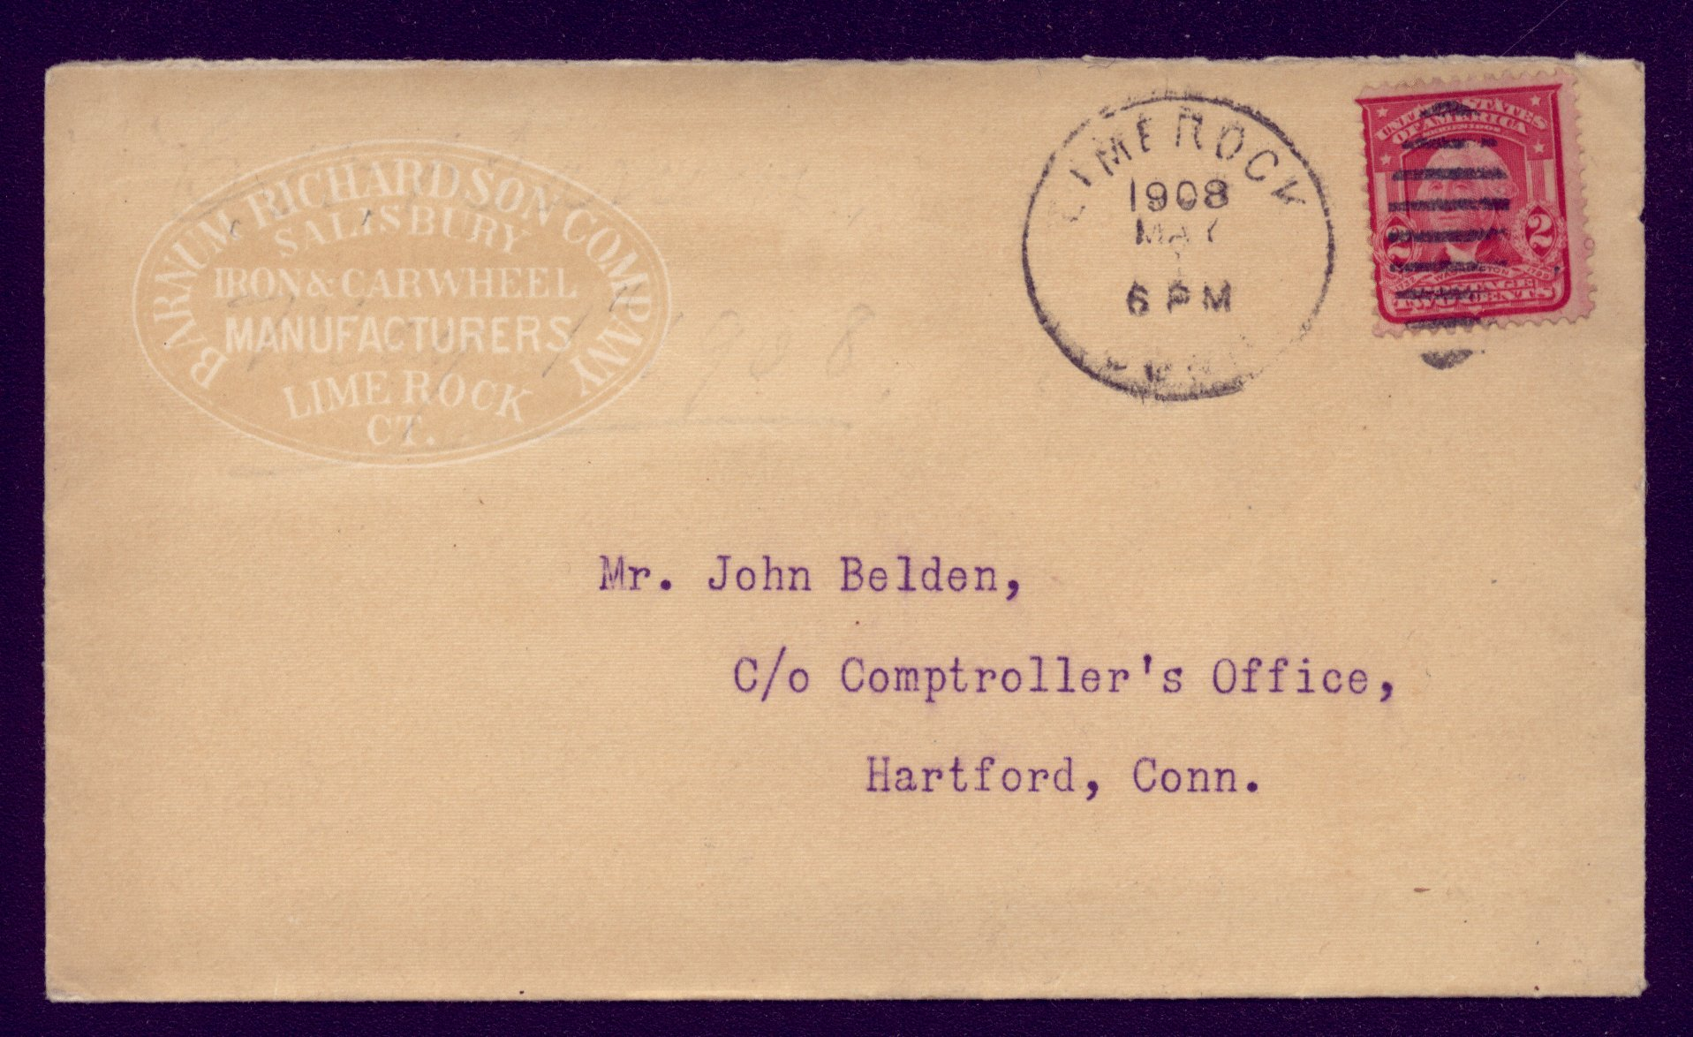
What is a protocol?
There are protocols for sending physical mail
What is the protocol?
Notes:
An agreed upon way to do a certain thing
If person a and b know how to commuicate in the same ”language/way”, it can be done easily.
Heard of the SOAP protocol ? The metadata is called the ”envelope”

Slide 17
Hyper Text Transfer Protocol – HTTP
HTTP is…
Designed for document transfer
Generic
not tied to web browsers exclusively
can serve any data type
Stateless
no persistent client/server connection

Slide 18
HTTP Protocol Definitions
MIME
Multipurpose Internet Mail Extensions
Standards for encoding different media types in a message
Originally developed for emailing files and messages in different languages

Slide 19
HTTP Protocol
When a user types in http://dir.yahoo.com/Recreation/sports/soccer/index.html, the browser creates a HTTP GET Request message and sends it over a TCP connection to the web server.
In the above case, the HTTP GET Request message would be:
GET /Recreation/sports/soccer/index.html HTTP/1.1
Host: dir.yahoo.com
User-Agent: Mozilla/5.0 (Windows NT 6.1; WOW64; rv:9.0.1)
Gecko/20100101 Firefox/9.0.1
Accept: text/html,application/xhtml+xml,application/xml;q=0.9,*/*;q=0.8
Accept-Language: da,en-us;q=0.7,en;q=0.3
Accept-Encoding: gzip, deflate
Accept-Charset: ISO-8859-1,utf-8;q=0.7,*;q=0.7
Connection: keep-alive
Cookie: B=2j1aerh7b0km0&b=3&s=lh
Cache-Control: max-age=0
“\r\n”
Notes:
https://en.wikipedia.org/wiki/List_of_HTTP_header_fields for more info on headers

Slide 20
HTTP Request messages
HTTP Request messages are sent from client to server.
There are a number of valid HTTP Request messages
Get – Used to request a web page from a web server
Head – Return the header of a web page, used by search engines to test the validity of hyperlinks
Post – Used to send data (e.g. results of registration form) to a web server
Put and Delete – Not typically implemented by browsers.
Request Line
Optional HTTP Header
“\r\n”
Optional Data
Additional information
such as browser being
used, media types accepted
Delimiter
Carriage return
Line feed
User data e.g. contents of completed form
Type of Request
(e.g. GET)

Slide 21
HTTP Response messages
HTTP Response messages are sent from server to client.
The Status Line gives information about the success of the previous HTTP Request
200 – 299 Success
300 – 399 Redirection – Document has been moved
400 – 499 Client Error – Bad Request, Unauthorised, Not found
500 – 599 Server Error – Internal Error, Service Overloaded
Status Line
Optional HTTP Header
“\r\n”
Optional Data
Success/Failure
Indication
Number between
200 and 599
Type of content returned
e.g. text/html or image/gif
Requested Data e.g. web page
Delimiter

Slide 22
HTTP Response messages
http://dir.yahoo.com/Recreation/sports/soccer/index.html returns a response.
In the above case, the HTTP GET Response message would be:
HTTP/1.1 200 OK
Date: Wed, 11 Jan 2012 09:45:35 GMT
Cache-Control: private
Connection: close
Transfer-Encoding: chunked
Content-Type: text/html; charset=ISO-8859-1
Content-Encoding: gzip
“\r\n”

Slide 23
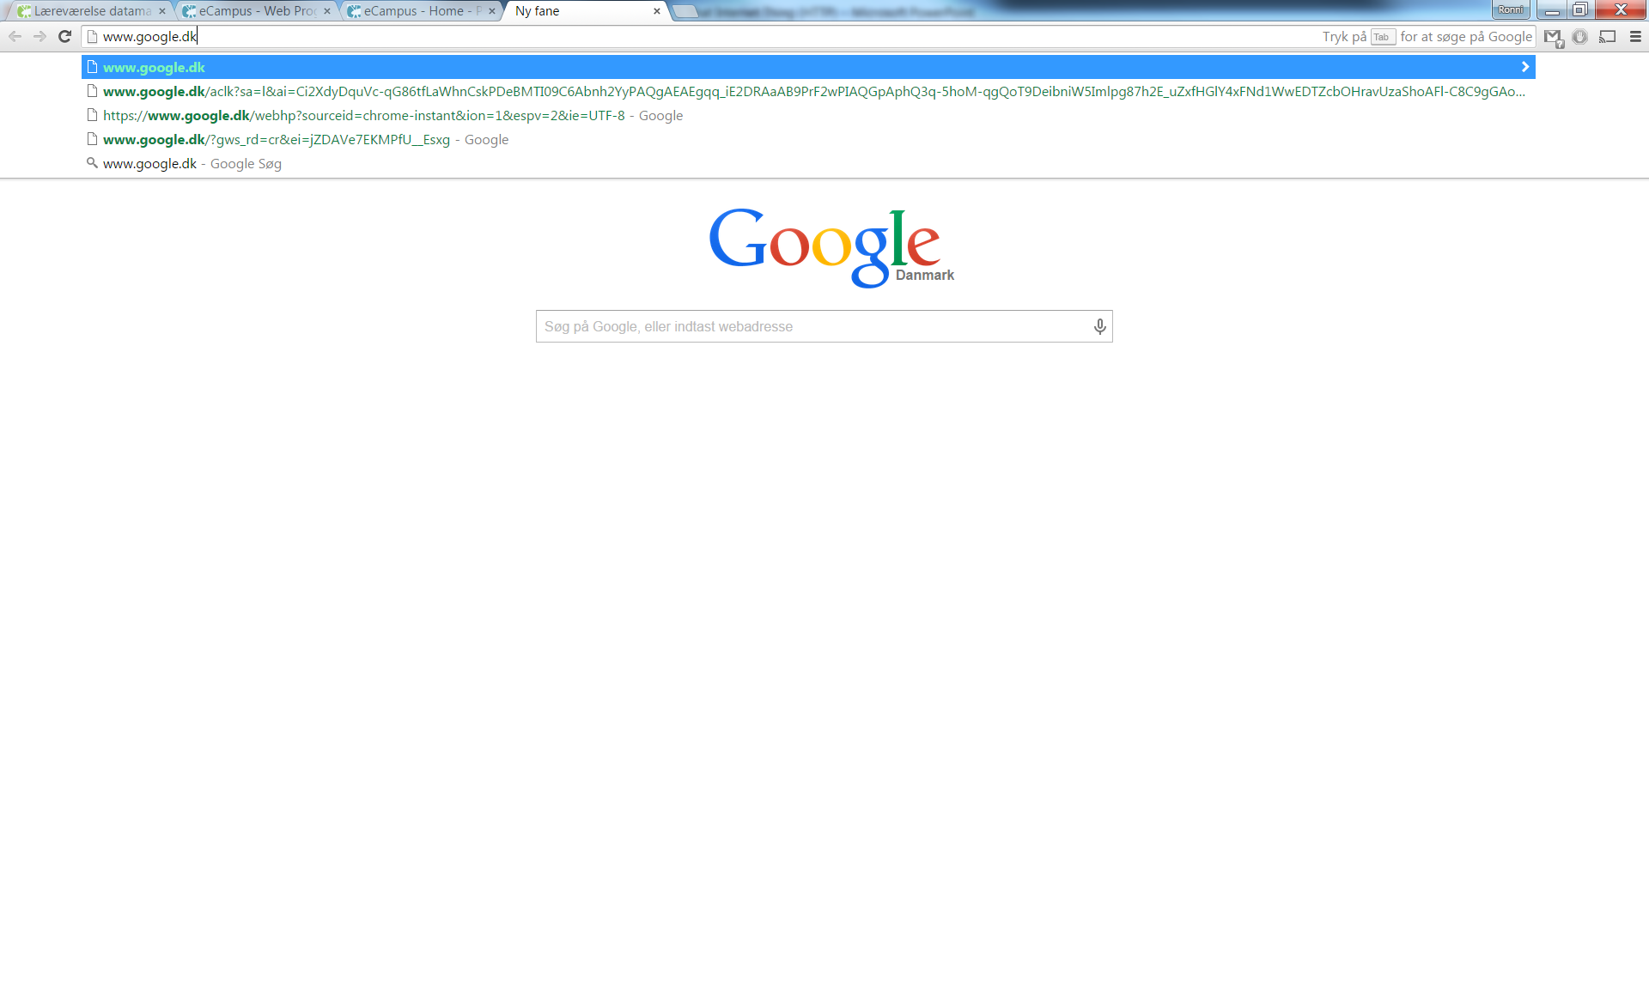
Lets dissect and see it in action!
We are here, pressing >return< in out browser.
What happens??
Notes:
Use Chrome Dev Tools
Or fiddler

Slide 24
Other Protocols
FTP - File Transfer Protocol
The Internet began development in the 1960s.
Moving a file from one computer to another computer required some form of removable medium (floppy disk or tape).
People required a protocol to reliably transfer files between any two computers connected to the Internet.
Why not use HTTP?
The HTTP protocol was developed in the late 1980s and the early 1990s.
HTTP provides a poor authentication mechanism of users of the protocol.
HTTP doesn’t easily allow files to be sent in both directions.
HTTP doesn’t allow files to be downloaded in separate stages.

Slide 25
FTP - Functions
The main function of FTP was to allow the sharing of files across the Internet.
Other functions included
Allowing computer users to use computers remotely.
Hiding file storage differences from the user. The format that files are stored on a Macintosh are different from a PC which in turn are different from a Unix workstation. Different length filenames also have to be accommodated.
Transfer of file data between computers has to be done reliably and efficiently. FTP should also allow transfer of very large files to be done in stages.

Slide 26
FTP
FTP is a client/server program
An FTP client program enables the user to interact with an ftp server in order to access files on the ftp server computer.
Client programs can be:
Simple command line interfaces.
E.g. MS-Dos Prompt - C:\ ftp ftp.maths.tcd.ie
Integrated with Web browsers
FTP provides similar services to those available on most filesystems:
list directories
create new files
download files
delete files
FTP uses TCP connections and the default server port for FTP is 21.

Slide 27
FTP - Transfer modes
Batch transfer
User creates list of files to be transferred by ftp program.
Users request is dropped into a queue of similar requests.
FTP program reads requests and performs transfers of files.
Transfer program can retry until successful.
Good for slow or unreliable transfers.
Interactive transfer
User starts ftp program
User can interactively list contents of directories, transfer files, delete files etc.
User can find and transfer files immediately
Quick feedback in case of mistakes, e.g., spelling errors

Slide 28
FTP - Sample Commands
Command | Description
ftp maths.tcd.ie | Open connection to computer
ls | List Directory contents
cd | Change to another directory
bin | Change to binary transfer, used for downloading executables.
get | Download a file from remote computer
put | Upload a file to the remote computer
mget | Start download of multiple files
mput | Start upload of multiple files

Slide 29
FTP - Check pointing
A data transfer may be aborted after only transferring part of a file.
This could be due to the client or the server crashing, the TCP connection being broken due to congestion, phone hanging up during dial up connection.
FTP allows the file transfer from where the transfer was stopped, no need to re-transfer part of file.
FTP achieves this by sending restart markers between the server and the client.
Restart markers are saved in a restart file by the client. Client sends restart marker when it wants to continue the transfer of a previously stopped transfer.

Slide 30
Quick example
Uploading files via a FTP client
Notes:
FileZilla

Slide 31
Other protocols
HTTPS
Transport layer security
Encrypted before it hits the wire
Prevents man in the middle attacks
HTTPS 442 Default
SMTP
Notes:
Secure HTTP
https://blog.hartleybrody.com/https-certificates/
Simple Mail Transfer Protocol

Slide 32
Caching web pages
Downloading HTML documents from servers can be slow due to a number of conditions:
Parts of the Internet can be congested
Dialup connection is typically very slow, 33Kbps or 56Kbps
Web server can have a lot of clients connecting to it at the same time, causing it to be overloaded.
If a user returns to previous HTML document, then this could require downloading the document from the server again.
A browser can hold copies of recently visited pages. This avoids having to download pages again.
An organization can use a HTTP proxy that caches documents for multiple users. Thus improving the speed at which pages can be displayed on each users computer.
Caching can be used server side to improve performance.

Slide 33
Browser Architecture
Browser
HTML
interpreter
D
i
s
p
l
a
y
D
r
i
v
e
r
Input from keyboard and
mouse
Controller
Javascript
interpreter
Output sent to
display
…
optional
plugins
HTTP
client
…
Other
client
Network Interface
Communication with
remote server

Slide 34
Browser Architecture
Browser has more components than a server:
Display driver for painting screen.
HTML interpreter for formatting HTML documents.
Plugins to display different content (e.g. Flash, Silverlight, Shockwave or Real Audio content)
HTTP client to fetch HTML documents from WWW server.
Other clients for other protocols (e.g., ftp, mail)
Controller also must accept input from the computer user through the mouse or keyboard.
JavaScript Engine

Slide 35
Describe:
What is a protocol?
What is the purpose of a DNS server, and why does it exist?
What happens, step by step, when you enter a URL in the browser, and navigate to it?
What is the difference between POST & GET Requests?
Use the rest of your time, to work with HTML || Git || Group and idea generation. Description of group project

